Slide 1
Workshop
Create Your Own Stellar Token
Hans Woppmann, Peter Pansegrau
29. May 2019
Presentation / Workshop at
Technical University of Munich
Chair of Strategy and Organization (Prof. Welpe)

Slide 2
Blue Orion – Token Workshop Agenda
P
Short Introduction
The story of Blue Orion (A startup in the world of blockchains)
Blockchain solutions & Stellar
What is a token (and why you like to have one?)
Tools we use in this workshop
A1: Public and Secret Keys
Understanding Assets and Trustlines
A2: Create your own token
A3: Send and receive tokens
Potential of Stellar – Value added Services with Blue Orion

Slide 3


Blue Orion – Token Workshop Team
Hans Woppmann - Founder, CTO
Senior IT-Consultant, Full stack Developer and Team lead in 50+ projects. Blockchain Developer since 2013, Founder SmartStellar.org. Worked at BMW, Atos, Altran. Munich, Germany
Peter Pansegrau - Co-Founder, Quality Assurance
Senior IT-Consultant, Testmanagement and Quality Engineering, Co-Founder SmartStellar.org. Worked at Atos, T-Systems. Munich, Germany
Luke Carriere - Co-Founder, CMO
Leading business development, marketing communications, and customer growth. MSc Digital Currency & MBA. New York, USA

Slide 4

Blue Orion – Token Workshop Your background
Why interested in blockchain?
Did you ever buy a Bitcoin?
Do you know other coins?
Who has plans for an own startup?
What‘s your motivation to be in the seminar?

Slide 5
Blue Orion – Token Workshop Agenda
P
Short Introduction
The story of Blue Orion (A startup in the world of blockchains)
Blockchain solutions & Stellar
What is a token (and why you like to have one?)
Tools we use in this workshop
A1: Public and Secret Keys
Understanding Assets and Trustlines
A2: Create your own token
A3: Send and receive tokens
Potential of Stellar – Value added Services with Blue Orion
Which Blockchain? Create Value? Business Case? Startup Challenges?

Slide 6
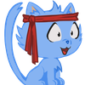

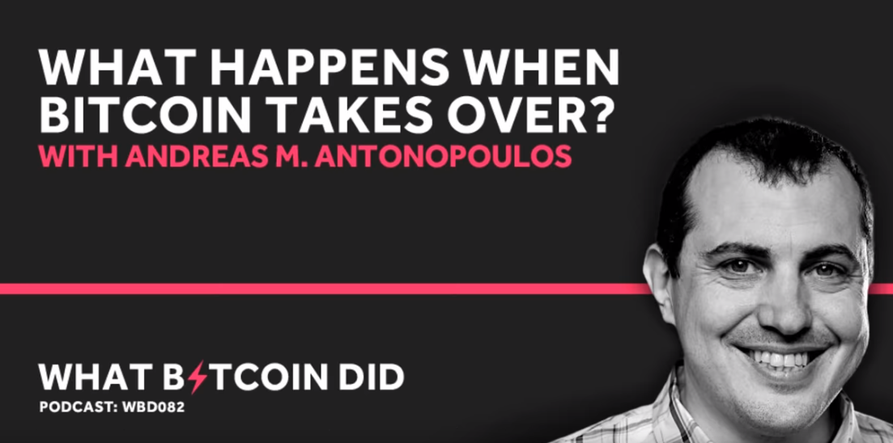
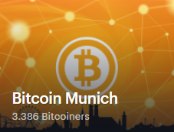
Blue Orion – Token Workshop The beginning
3 years ago
Fascination for new technologies
Bitcoin Meetups
Positive spirit from blockchain community
Open source spirit
Challenge the banking system
Do something you really like / Passion

Slide 7


Blue Orion – Token Workshop The next step
2 years ago
Alternative to traditional banking system
Change the (banking) world
Bank the unbanked!
Use own skills/potential for a new product
Be your own boss
Fun at work
Get crazy rich?
Do something meaningful

Slide 8

Blue Orion – Token Workshop Select Blockchain
2 years ago
Which blockchain / network to select?
Where to start? Bitcoin everywhere …
Understand the different type of blockchains? (Bitcoin, Ethereum, IOTA, Dash …)
Select a blockchain that fits to your use case
Etherium – Turing-complete, but security risks, transaction costs …
Find software developers with blockchain skills
Complex technology
Existing sources/solutions limited
Unusual workflows (blockchain protocol)

Slide 9
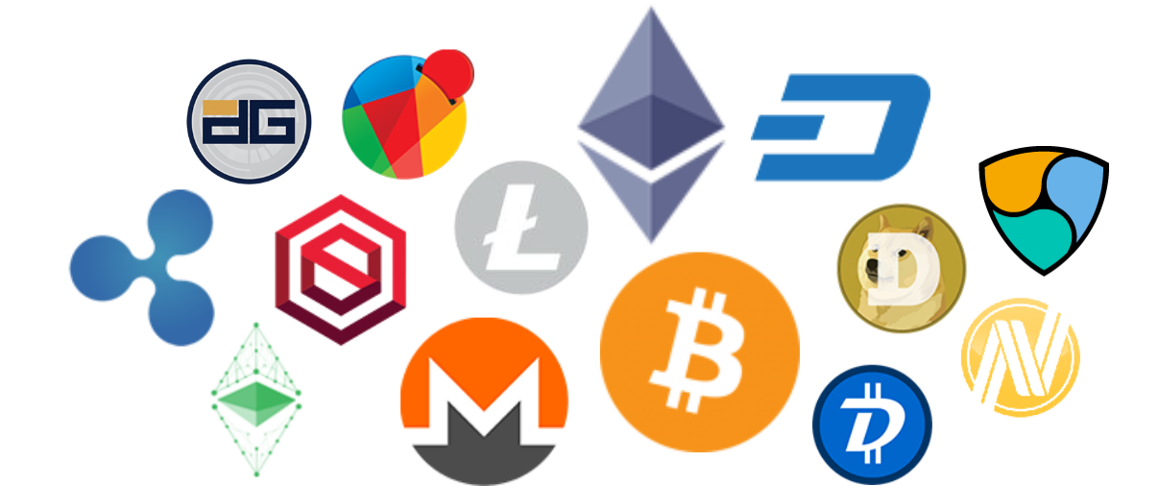
Blue Orion – Token Workshop Select Blockchain
1 year ago
Analyse blockchains
Huge invest of time to analyse about top 200 coins/systems
Check communities – spirit important
Existing SDKs
Quality of documentation
Specific technical features (e.g. speed, transaction costs, scalability)
Popular

Slide 10

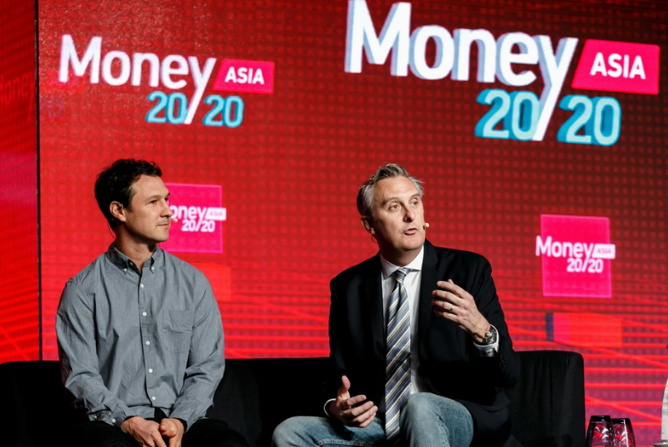
Blue Orion – Token Workshop Select Blockchain
1 year ago
Why Stellar?
Features: fast (2-5 sec), scaleable (1000 / sec), very low fees
Supports smart contracts
SDks for different languages
Community spirit really good
Positive view on exiting financial systems
Connect existing payment systems
Integrated decentralized exchange
Founder has a high reputation (Jed McCaleb)
Partner IBM (Jesse Lund)

Slide 11

Blue Orion – Token Workshop Identify a product/service
1 year ago
What could be a really good value added service or product? The technology – How can it be used?
Bank the unbanked
Low international transaction fees
Immutable ledger
Open protocol (enables innovations)
Fast, Availability 24/7
Independency from traditional banks
The product - Not another wallet
What is actually missing in Stellar universe?
Provide traditional banking services on new platform?
Check for existence: Discussion in the community

Slide 12

Blue Orion – Token Workshop Identify a product/service
Challenges with the new technology, adoption is ongoing …
New technology not main stream adopted (similar to internet in early 90ies)
General advantages are unknown / not transparent for end users
about advantages compared to existing financial services
new blockchain related use cases (e.g. proof of existence)
Blockchain market crashes 2018
Bad image because of dark net, virus, exchange hacking
Fear of new technology
Due to bad managed ICOs decrease of user trust
Current features not very user friendly (e.g. loss of private key)
Benefits are more important for 3rd world

Slide 13
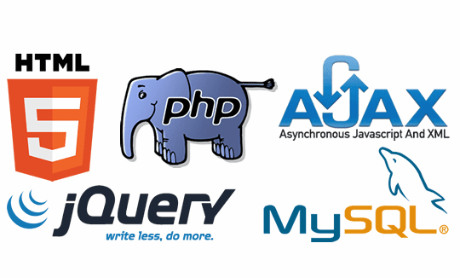
Blue Orion – Token Workshop Create the product
Gain freedom to have time and money -> dicipline, self organization, savings
Select the technologies and tools
Javascript, Ajax, PHP, HTML5
Apache Server, Ubuntu
Stellar SDK
Communication: Skype, Keybase
Development of the service
Continuous interaction with community
Interaction with other Stellar projects (Stellar Guard)

Slide 14
Blue Orion – Token Workshop Create the product
Design the user interface – Problem of user experience & blockchain?
Create a user friendly interface
Create content to explain the service to users
The “Voucher” – easy to use – fast access to the services
With B2B target group is easier
Create integrated products -> user doesn’t know blockchain is used!

Slide 15
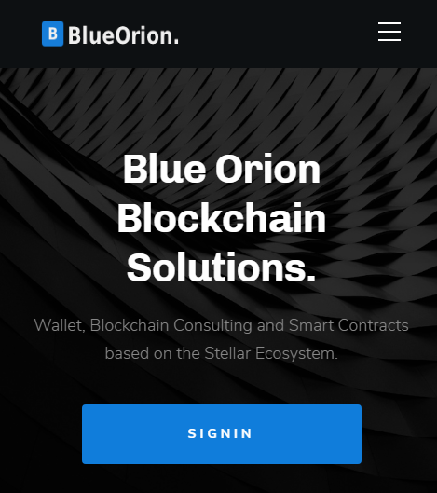
Blue Orion – Token Workshop Final Product
now
Our solution: Blue Orion service platform with unique features.
Timed Payments
Multi Payments
Voucher Management
Proof of Existence
Our business model
Project related model B2B, providing blockchain services/consulting
Fee-based model on wallet services

Slide 16



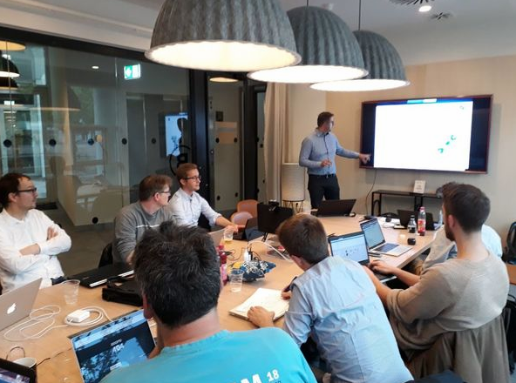
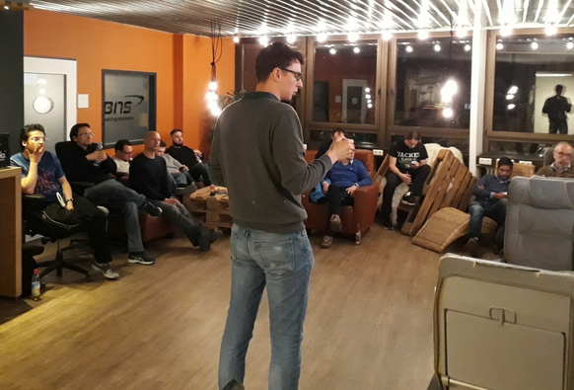
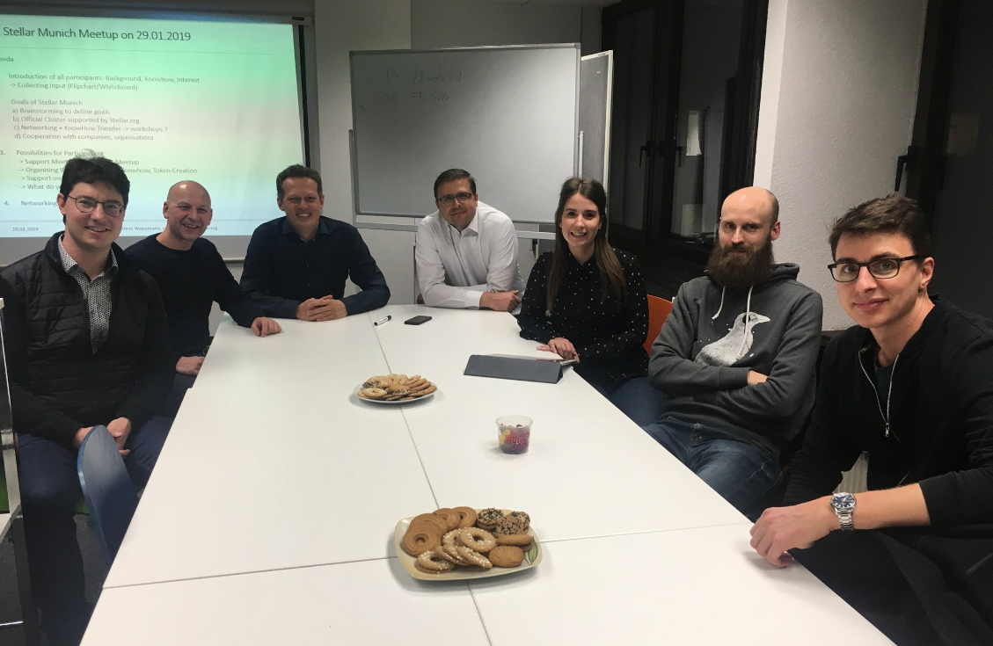
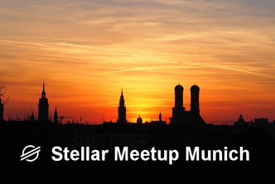
Blue Orion – Token Workshop Marketing / Networking
Use social media: reddit, twitter, linkedin
Be present at Stellar related blogs/forums
Organize Meetups
Find sales co-founder on an equity base
Get in touch with the Stellar Foundation (based in San Francisco)
Participate in conferences

Slide 17

Blue Orion – Token Workshop A product and what next?
How to earn real money (not tokens)?
Define an equity model
Offer equity to co-founder
Present your startup (angel.co)
Search team members based on equity
Find clients: B2B with crypto background (angel.co)
Find investors/partners
Stellar developer challenge
Stellar fund models
Participate in startup challenges (BayStartup)
ICO
Selling the product: fee model on services

Slide 18


Slide 19
Blue Orion – Token Workshop Agenda
P
Short Introduction
The story of Blue Orion (A start up in the world of blockchains)
Blockchain solutions & Stellar
What is a token (and why you like to have one?)
Tools we use in this workshop
A1: Public and Secret Keys
Understanding Assets and Trustlines
A2: Create your own token
A3: Send and receive tokens
Potential of Stellar – Value added Services with Blue Orion

Slide 20
Blue Orion – Token Workshop What is a token and why you like to have one
Definition by Wikipedia
“Token is a unit of value issued by a tech or crypto start-up, intended to be a piece in the ecosystem of their technology platform or project. …”
Using an existing blockchain (Ethereum, Stellar, EOS, Cardano, NEO, Tron, …)
Easier to create than a new coin + blockchain
Three main types of token
Security token (represents a value / share of a company or asset)
Utility token (e.g. platform access, governance, non-finance)
Payment token

Slide 21
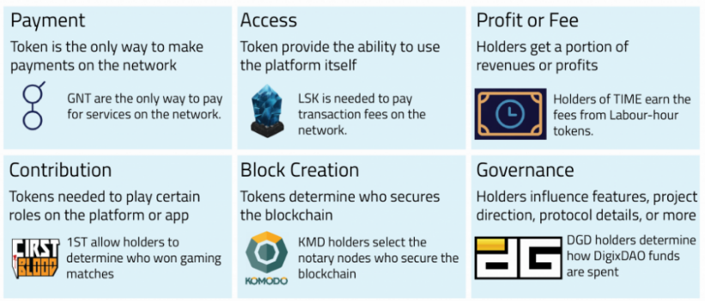
Blue Orion – Token Workshop What is a token and why you like to have one
Why creating your own token?
Note: On Stellar token are also called assets!

Slide 22
Blue Orion – Token Workshop Agenda
P
Short Introduction
The story of Blue Orion (A start up in the world of blockchains)
Blockchain solutions & Stellar
What is a token (and why you like to have one?)
Tools we use in this workshop
A1: Public and Secret Keys
Understanding Assets and Trustlines
A2: Create your own token
A3: Send and receive tokens
Potential of Stellar – Value added Services with Blue Orion

Slide 23

Blue Orion – Token Workshop Tools we will use during the workshop
P
Tools to be used in the workshop
Text Editor To store all the keys created in the workshop
Stellar Laboratory Webinterface provided from the Stellar Foundation https://www.stellar.org/laboratory/
Stellar Expert Account and Asset Explorer https://stellar.expert/explorer/public/
Blue Orion Web-Wallet http://blueorion.cc/signin
PPT Slides - Workshop TUM http://blueorion.cc/documents/tum-workshop.pdf
Notes:
Warum zeigen wir verschiedene Tools?
Nutzung des Stellar-Network geht auch komplett ohne wallet
Wallet ist aber cooler :-)
EINE Aktion bei dem Ablauf zur Token-Erzeugung ist aktuell nur auf technischem Level mit Laboratory möglich (Funktion wird im Wallet noch ergänzt)
- „laboratory“ woher, warum, wozu
- „Expert“woher, warum, wozu

Slide 24
Blue Orion – Token Workshop Agenda
P
Short Introduction
The story of Blue Orion (A start up in the world of blockchains)
Blockchain solutions & Stellar
What is a token (and why you like to have one?)
Tools we use in this workshop
A1: Public and Private Keys
Understanding Assets and Trustlines
A2: Create your own token
A3: Send and receive tokens
Potential of Stellar – Value added Services with Blue Orion

Slide 25

Blue Orion – Token Workshop Lesson A1: Content
P
Lesson Goals A1
Understand public and secret keys
Create keys/accounts on TestNet + PublicNet
Fund the accounts with Friendbot
Check balance with account viewer

Slide 26

Blue Orion – Token Workshop Lesson A1: Understanding public and secret keys
P
An account is represented by Public and Private Key
(The Private Key is sometimes also called the Secret Key or Secret Seed within the Stellar community)
Keys will be created based on a specific crypto algorithm
(based on ED25519, see also https://en.wikipedia.org/wiki/EdDSA)
Public Key comparable with bank account number
56 Characters
Starts with a “G”
e.g.: “GBITJ65YIQGIDHJEPEFW33RDXDLU7U3NRVNAAIJA424GGKGPB2I66KVB”
Private Key comparable with password
56 Characters
Starts with a “S”
e.g.: “SA4CNBDDTZVCNQMBCI6HCUKNQE35EBS3EBZ2AX6XXJZ4MGFIVBMWH34U”
Notes:
Details können für Interessiert im Nachgang besprochen werden (hier nicht Scope):
- warum kann das jeder erzeugen
- warum ist das sicher

Slide 27
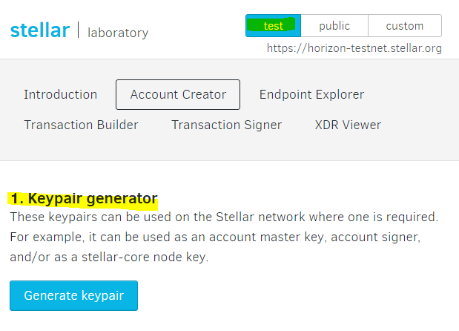
Blue Orion – Token Workshop Lesson A1: Create & activate an account (via laboratory)
P
https://www.stellar.org/laboratory/
Create Keys
Generate a key pair
Safe keys
Note: A new Stellar account needs to get activated by sending lumen to that account from another existing account (Minimum 0.5 lumen, to have some value left for fees, at least 1 lumen is recommended)
Notes:
Nur zur Info – es geht auch im „laboratory“, aber wir nutzen direkt das Wallet
weil wir dort die neuen Accounts automatisch „aktivieren“ können

Slide 28

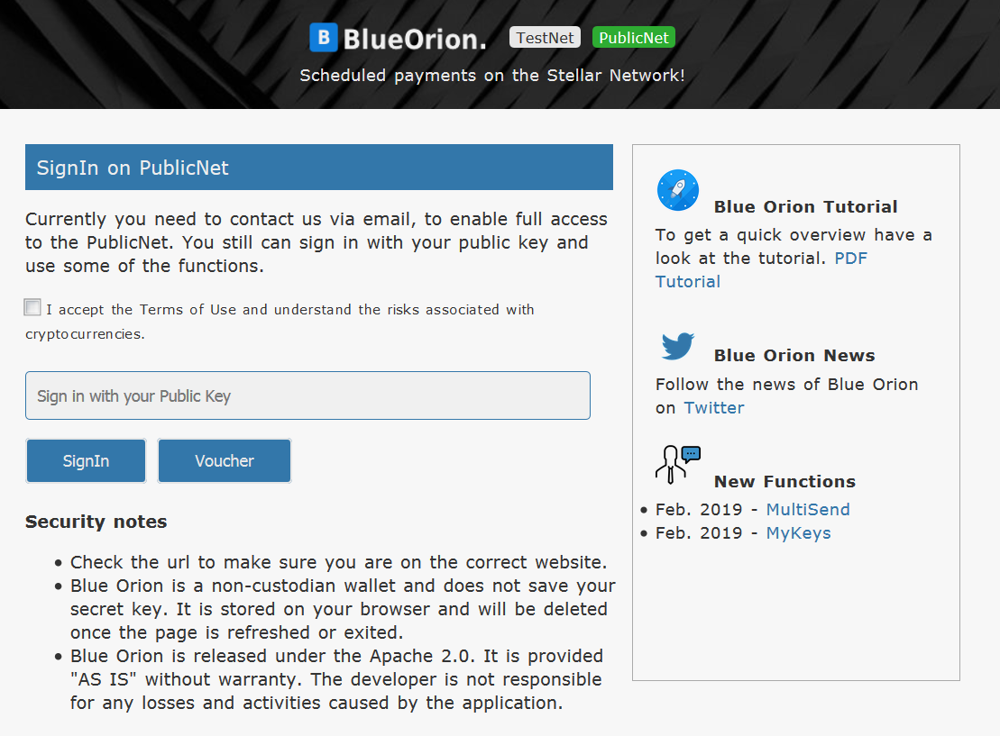
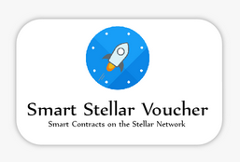
Blue Orion – Token Workshop Lesson A1: Create & activate an account (via wallet)
P
PublicNet
https://blueorion.cc/signin
Create Keys on PublicNet with Blue Orion by using a voucher.

Slide 29
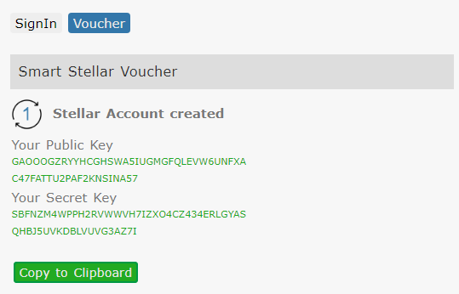
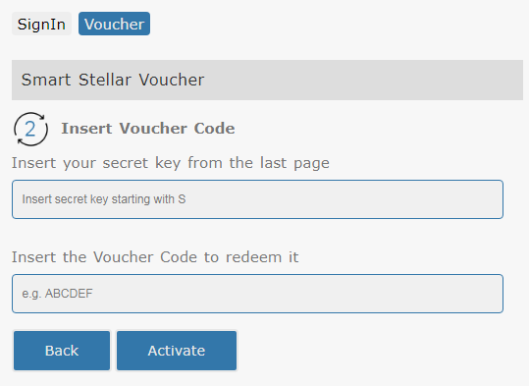
Blue Orion – Token Workshop Lesson A1: Create & activate an account (via wallet)
P
PublicNet
https://blueorion.cc/signin
Voucher Redemtion in 2 Steps

Slide 30
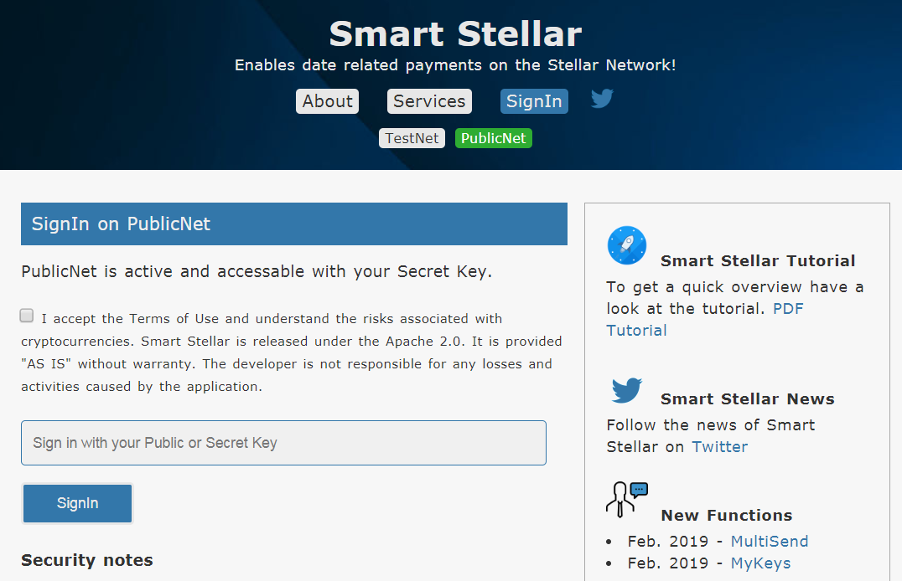
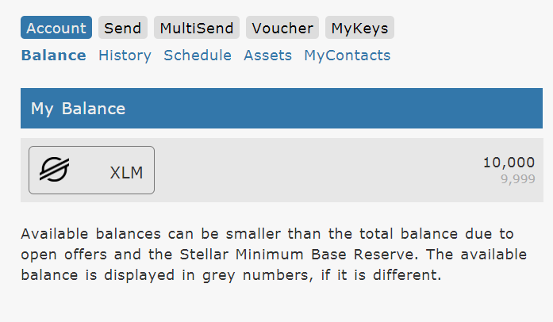
Blue Orion – Token Workshop Lesson A1: Check account & balance (via wallet)
P
PublicNet
https://blueorion.cc/signin
Login with your PublicKey and check your Account

Slide 31
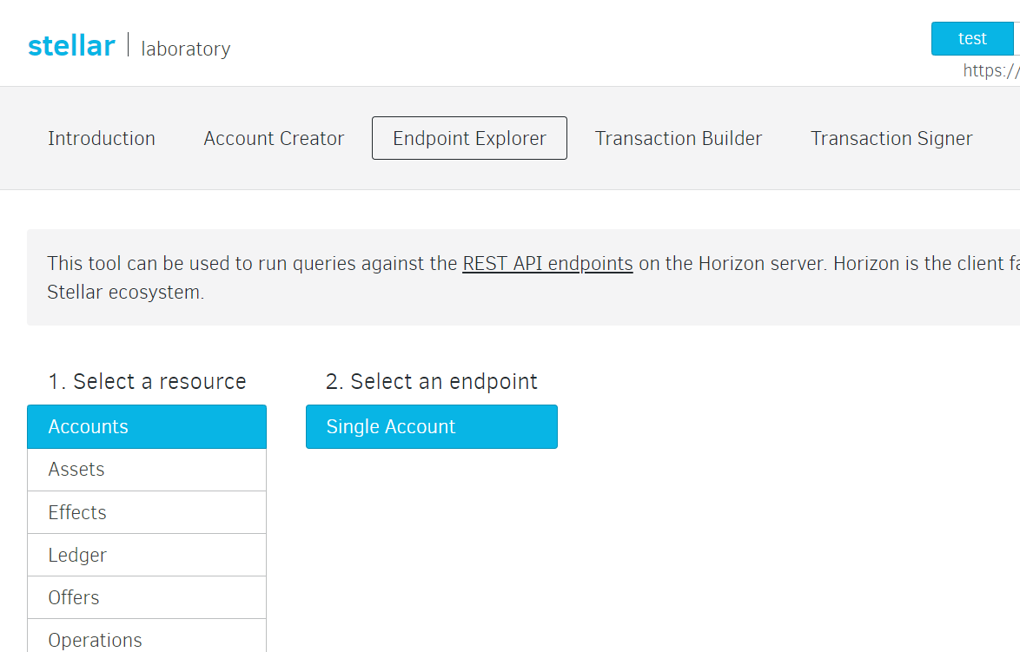
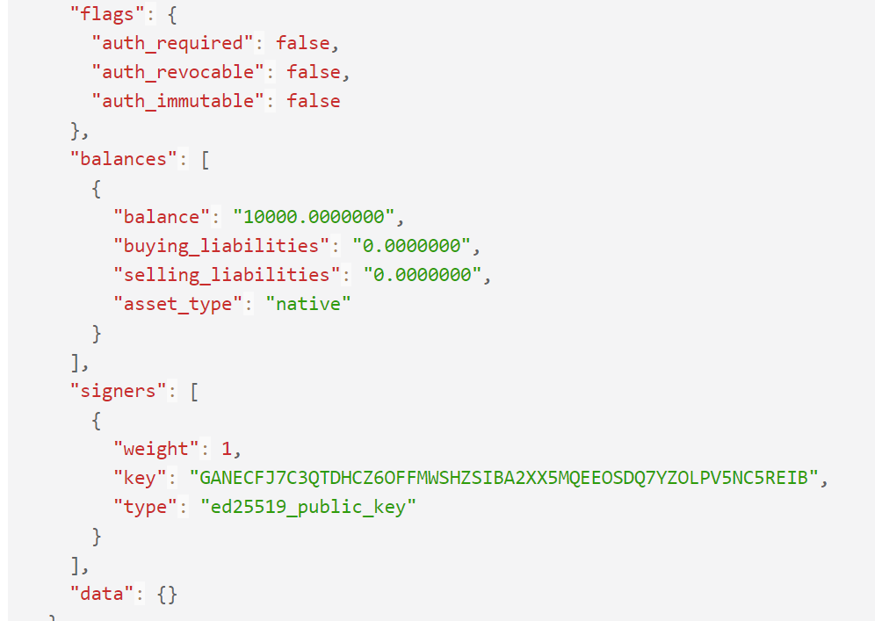
Blue Orion – Token Workshop Lesson A1: Check account & balance (via Stellar | laboratory)
P
PublicNet
https://www.stellar.org/laboratory/

Slide 32
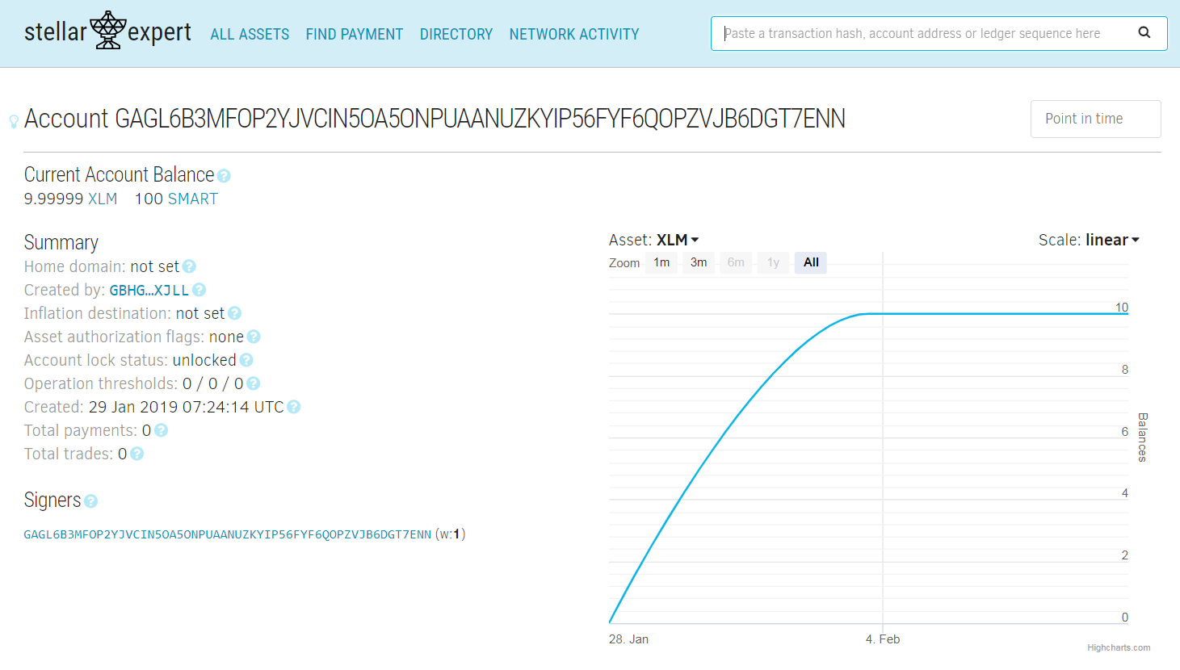
Blue Orion – Token Workshop Lesson A1: Check account & balance (via Stellar.Expert)
P
PublicNet
https://stellar.expert/explorer/public/
Proof that your account not just exists in the wallet

Slide 33

Blue Orion – Token Workshop Lesson A1: The end
P
Check Results:
You should have your own key pair for a Stellar account on the PublicNet
You have stored your keys in a text file or something similar
You own an account with some Lumen

Slide 34
Blue Orion – Token Workshop Agenda
P
Short Introduction
The story of Blue Orion (A start up in the world of blockchains)
Blockchain solutions & Stellar
What is a token (and why you like to have one?)
Tools we use in this workshop
A1: Public and Private Keys
Understanding Assets and Trustlines
A2: Create your own token
A3: Send and receive tokens
Potential of Stellar – Value added Services with Blue Orion

Slide 35
Blue Orion – Token Workshop Understanding Assets and Trustlines
Content in detail (no active part yet)
Understand assets and trustlines
Add and remove an asset

Slide 36
Blue Orion – Token Workshop
Stellar Native Currency
Short name is XLM, also called “Lumens”
Used as the exchange currency on the stellar network (liquidity, enables exchange path)
Assets = Token (comparable to shares + issuing organization)
on Stellar token are also called “asset”
An asset can be defined by Asset-Code (code length 1 to 12) and Issuer-Account Issuer: the issuer is defined by the issuing account
Example: the Asset “SMART” is defined by its name and the issuer-key GAG6FFW65DKL3XQ7SQBQVB6MZ4CAEN23VSX5GXUEMXHAEBNPRHQZIKQP

Slide 37
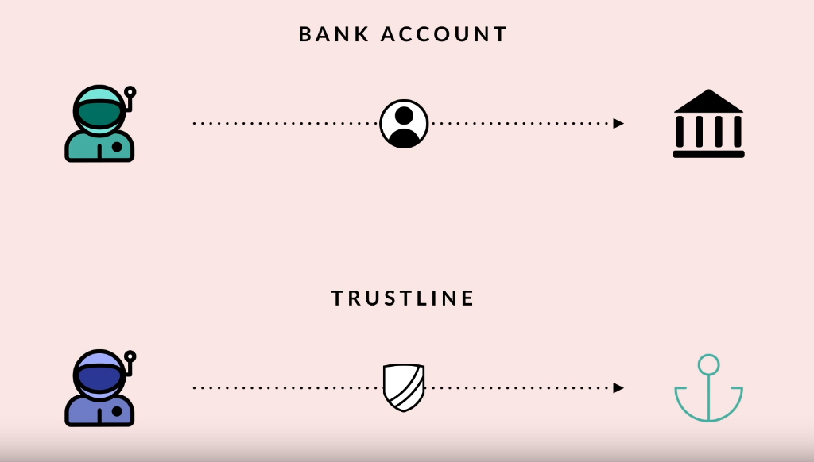
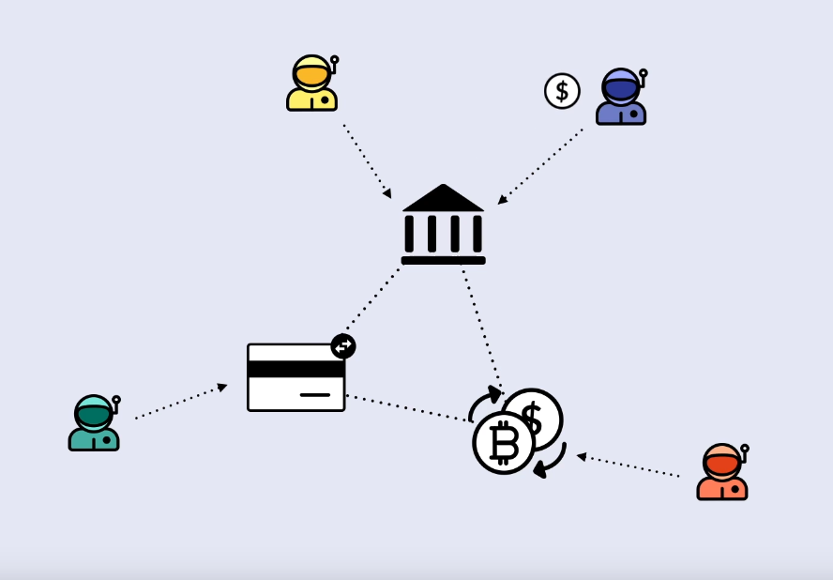
Blue Orion – Token Workshop
Anchors
An anchor is an entity that acts as a bridge between existing currencies and the Stellar Network, and involves setting up systems like a compliance server and a bridge server. Stronghold as a anchor provides US$ as a stable token on Stellar.
Trustline
User agrees to allow a certain token (asset, share) on his account (unlike Ethereum)
Note: Before an account can send you an asset you first need to establish a trustline to this asset
Value added feature
Spam prevantion
Distributor could decide who is allowed to receive its specific token -> easy to do KYC

Slide 38
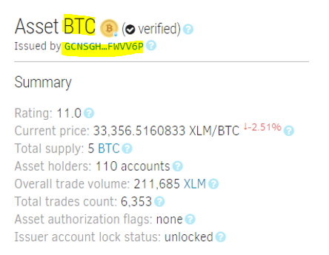
Blue Orion – Token Workshop
Info
Select Asset + Issuer from stellar.expert

Slide 40
Blue Orion – Token Workshop Agenda
Short Introduction
The story of Blue Orion (A start up in the world of blockchains)
Blockchain solutions & Stellar
What is a token (and why you like to have one?)
Tools we use in this workshop
A1: Public and Private Keys
Understanding Assets and Trustlines
A2: Create your own token
A3: Send and receive tokens
Potential of Stellar – Value added Services with Blue Orion

Slide 41
Blue Orion – Token Workshop A2: Create your own token
Lesson Goals A2
Create Issuer Account
Create Trustline on Distribution Account
Transafer Tokens from Issuer to Distribution Account

Slide 42
Blue Orion – Token Workshop A2: Issuer and Distributor what for?
Stellar solution – issuer and distributor
What is an Issuer Account?
The issuer account can create new token!
What is an Distribution Account?
The goal of distribution account is to act as the mechanism for distributing tokens to the public.
Asset Limitation
If you want to set a limit of max. created assets, you can remove the rigths to create new token from the issuer account.

Slide 43
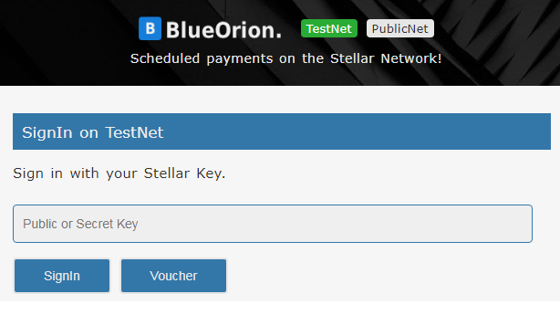
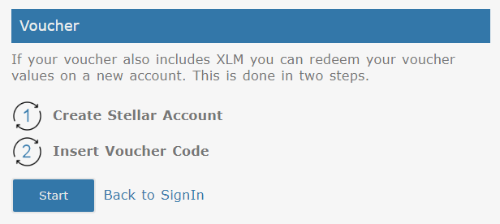
Blue Orion – Token Workshop
Create Issuer Account with voucher

Slide 44
Blue Orion – Token Workshop
Check your accounts in your textfile!
You should have
Issuer Account Public Key GAPD24FSIDQG74K5JSBFP3KDLNGUJV5QNMLDD5YZJBAZV2K67MVEEKIW Secret Key SAL7BBKIBREYVYWJ76P3Z3QHZWRNX5RBKD67US4EJKEYTGJREAFQFSLI
Distributor Account Public Key GALW3EIKVQ25N7HKTPJGDDTT42L6UO2VFTSBPLVFASAQ5TSDPGE5RSTZ Secret Key SAFLNZXUVFZSRJD6KZPYTWJN7LGTLZJSOUNHDACKQPN4Y3BD2FLICJNE
Your token name “MyToken”
Base Fee (required on testnet) 100 stroops (smallest entity)

Slide 45
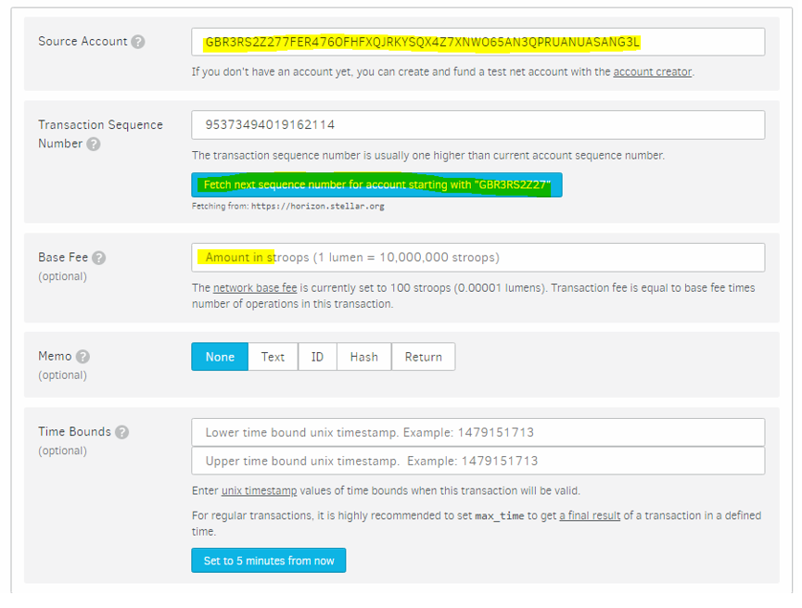
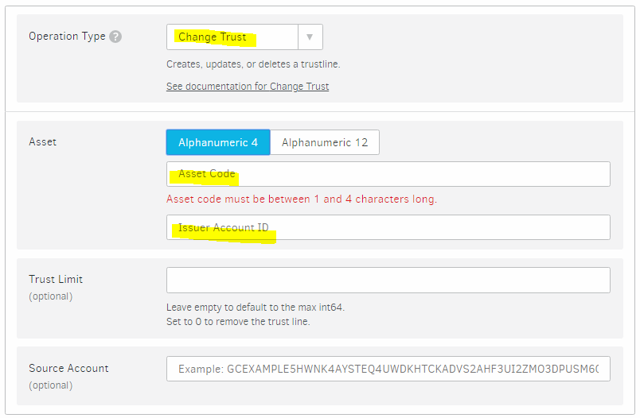
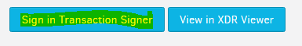
Blue Orion – Token Workshop
1a) Create Trustline on Distribution Account
See Lesson A2 -> stellar.org/laboratory/ -> “Transaction Builder” Source Account = Distribution Account

Slide 46
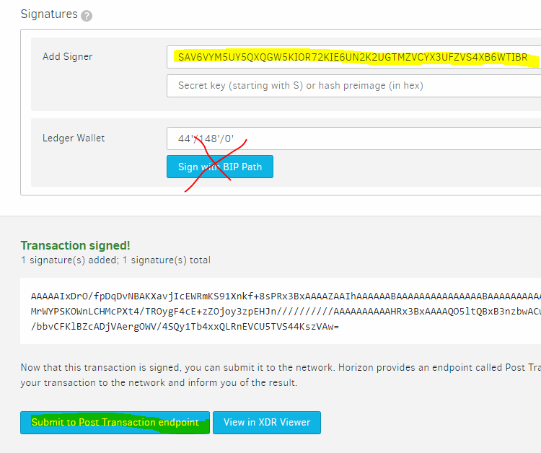
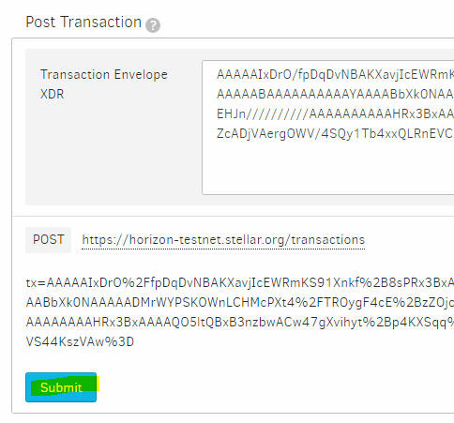
Blue Orion – Token Workshop
1b) Create Trustline on Distribution Account
See Lesson A2 -> stellar.org/laboratory/ -> “Transaction Builder” Source Account = Distribution Account

Slide 47
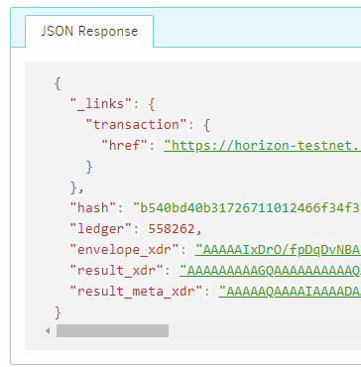
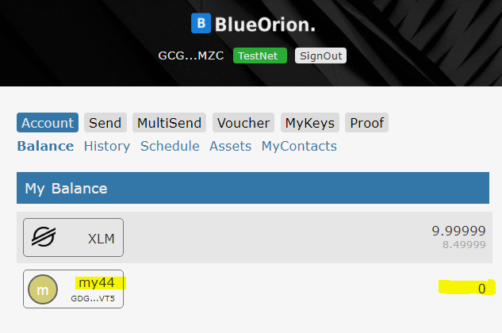
Blue Orion – Token Workshop
1c) Create Trustline on Distribution Account
Result on Laboratory Check with wallet if trustline exists

Slide 48
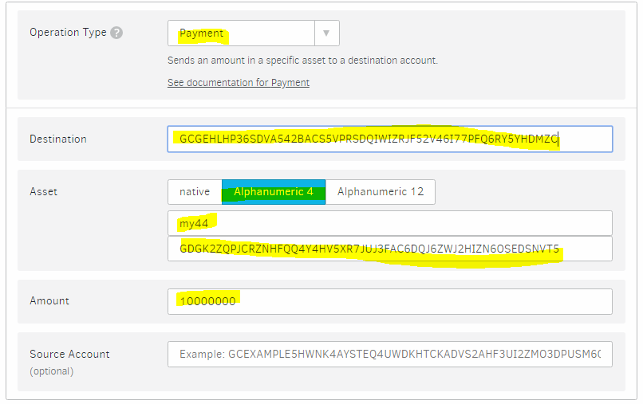
Blue Orion – Token Workshop
2a) Transfer Tokens from Issuer to Distribution Account
See Lesson A2 -> stellar.org/laboratory/ -> “Transaction Builder” Source Account = Issuer Account

Slide 49
Blue Orion – Token Workshop
2b) Transfer Tokens from Issuer to Distribution Account
See Lesson A2 -> stellar.org/laboratory/ -> “Transaction Builder” Source Account = Issuer Account

Slide 50
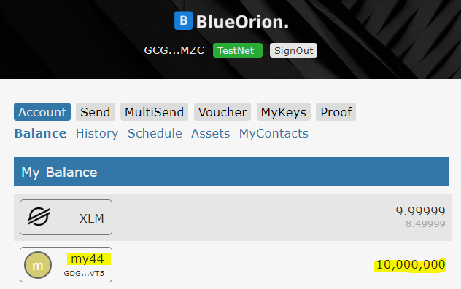
Blue Orion – Token Workshop
2c) Transfer Tokens from Issuer to Distribution Account
Result on Laboratory Check with wallet if token has been transfered

Slide 51
Blue Orion – Token Workshop A2: Create your own token – The end
Check results
Issuer Account exist (keys stored in text file)
Distribution Account (keys stored in text file)
all actual available tokens on distribution account

Slide 52
Blue Orion – Token Workshop Agenda
P
Short Introduction
The story of Blue Orion (A start up in the world of blockchains)
Blockchain solutions & Stellar
What is a token (and why you like to have one?)
Tools we use in this workshop
A1: Public and Private Keys
Understanding Assets and Trustlines
A2: Create your own token
A3: Send and receive tokens
Potential of Stellar – Value added Services with Blue Orion

Slide 53
Blue Orion – Token Workshop Lesson A3: Send and receive XLM and tokens
P
Lesson Goals A3
What next?
what can you use the wallet for
(Check History)
trust a token from a friend
send token to friends

Slide 54
Blue Orion – Token Workshop
P
What next?
Transfer your tokens to friends
Other usecases -> services: security token (crowdfunding), usibility token for online applications

Slide 55
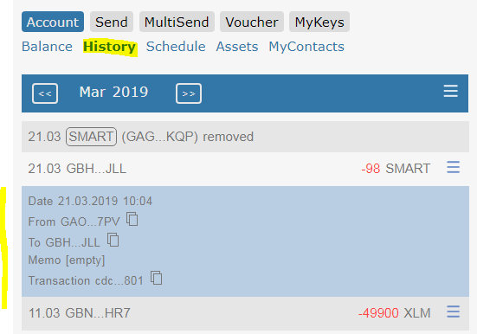
Blue Orion – Token Workshop Lesson A3: Check balance & history (via wallet)
P
https://blueorion.cc/signin

Slide 56
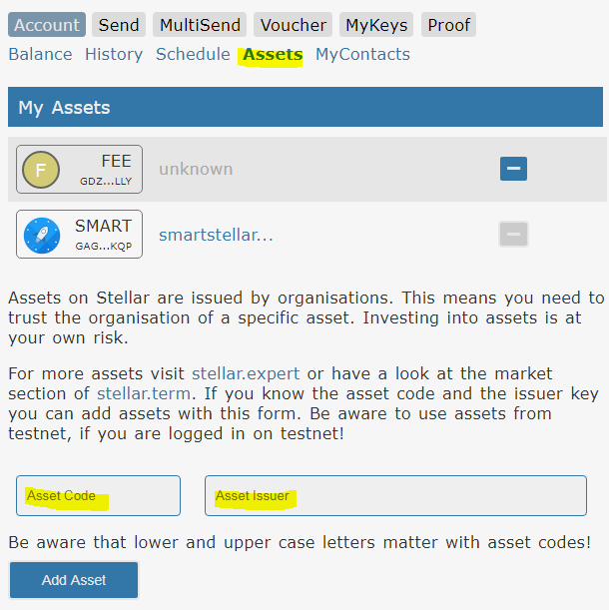
Blue Orion – Token Workshop Lesson A3: Add Trustline / Asset
P

Slide 57
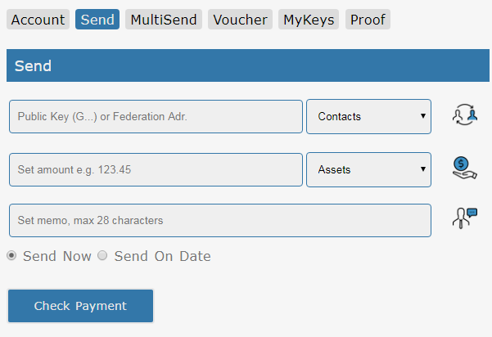
Blue Orion – Token Workshop Lesson A3: Send Payments
P

Slide 58
Blue Orion – Token Workshop A3: Send and receive XLM and tokens – The end
P
Check results
Simple usage of a wallet
Shared your own tokens

Slide 59
Blue Orion – Token Workshop Agenda
P
Short Introduction
The story of Blue Orion (A start up in the world of blockchains)
Blockchain solutions & Stellar
What is a token (and why you like to have one?)
Tools we use in this workshop
A1: Public and Private Keys
Understanding Assets and Trustlines
A2: Create your own token
A3: Send and receive tokens
Potential of Stellar – Value added Services with Blue Orion

Slide 60
Blue Orion – Token Workshop Outlook - Value add services
Potential of Stellar technology/blockchain
Timed payments
Multi Send service
MyKeys (Multi Account Management)
Proof of Existence

Slide 61
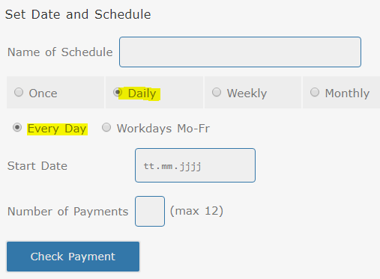
Blue Orion – Token Workshop
Timed Payments

Slide 62
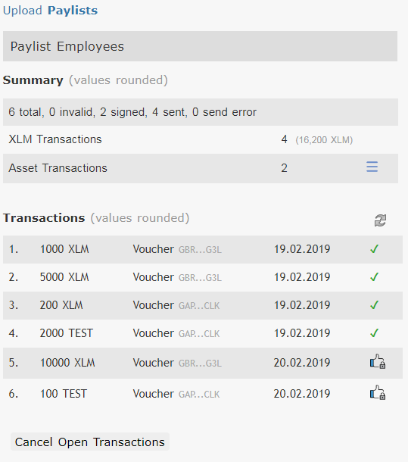
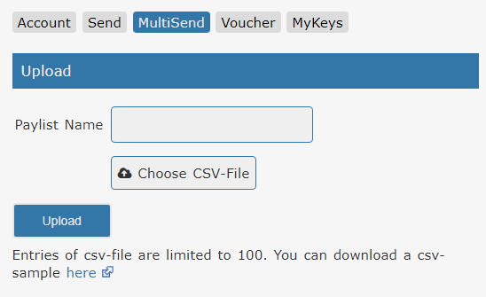
Blue Orion – Token Workshop
MultiSend
Easy send 100 or 1000 payments defined in a CSV-File
Check status of all payments

Slide 63
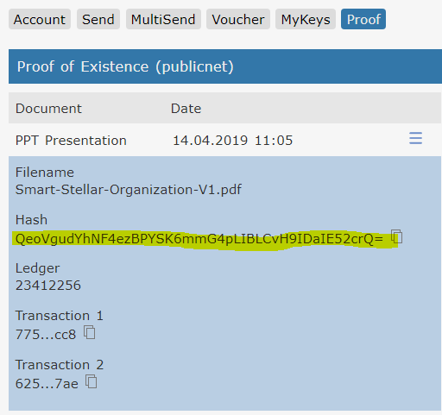
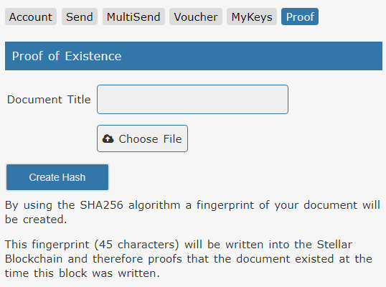
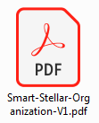
Blue Orion – Token Workshop
Proof of existence (1)
Blockchain solution for securing
intellectual property assets and innovation processes
1a) Create hash of file
1b) Save hash into blockchain

Slide 64
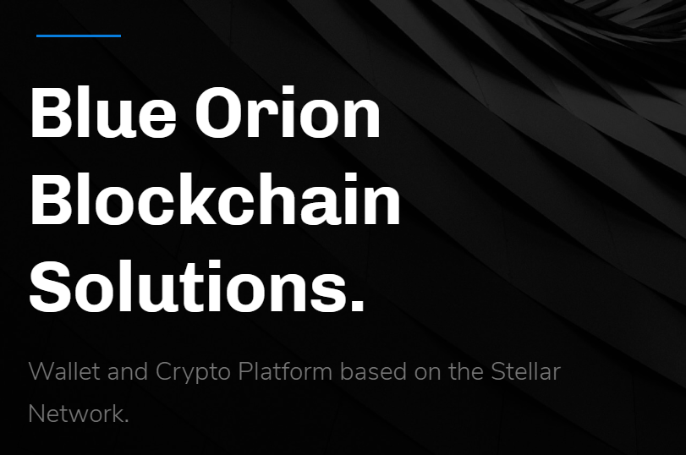
Thank You
Hans Woppmann
Phone: +49 176 6093 9333
Peter Pansegrau
Phone: +49 163 166 3738
eMail: contact@blueorion.cc
Twitter: twitter.com/blueorioncc

